Slide 1
Obstacle detection and distance estimation for visually impaired people.
Group number : 03
Raj Bhensadadia (201501011)
Bansi Gajera (201501028)
Dhwani Mehta (201501054)
Kanan Vyas (201501121)

Slide 2
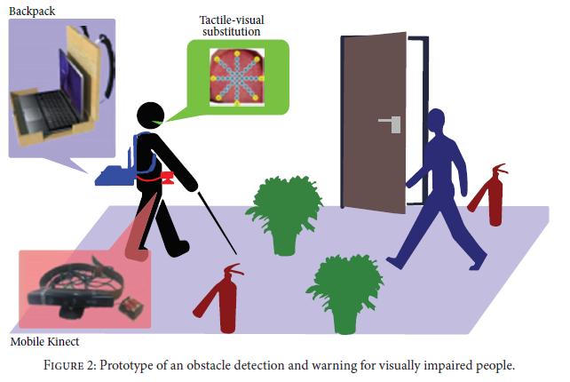
Motivation
Pham, Huy-Hieu, Thi-Lan Le, and Nicolas Vuillerme. "Real-time obstacle detection system in indoor environment for the visually impaired using microsoft kinect sensor." Journal of Sensors 2016 (2016).

Slide 3
Project Outline
Problem statement:
Obstacle detection and distance estimation of the objects using a real-time video and path navigation to aid visually impaired people.
Project Outline:
Object detection and recognition.
Distance estimation of the object

Slide 4
Dataset
ImageNet - [ 999 classes ]
MS COCO [1] - [ 90 classes ]
Pascal Visual Object Detection (VOC) [2] - [ 20 classes ]
[1] Lin, Tsung-Yi, et al. "Microsoft coco: Common objects in context." European conference on computer vision. Springer, Cham, 2014.
[2] Everingham, M. , Van Gool, L. , Williams, C. K. I. , Winn, J. and Zisserman, A. International Journal of Computer Vision (2010)

Slide 5
Literature review
Using computer vision concepts:
SIFT and SURF - can detect only known, specific objects with distinct texture
Edge detection and corner detection - mainly for door detection [3]
Ground plane estimation algorithm based on RANSAC [4]
not a feasible approach :
Slow
Not very accurate
Less number of trained classes
[3] Sujith, B., and V. Safeeda. "Computer Vision-Based Aid for the Visually Impaired Persons-A Survey And Proposing New Framework." International Journal of Innovative Research in Computer and Communication Engineering (2014).
[4] Rodríguez, Alberto, et al. "Assisting the visually impaired: obstacle detection and warning system by acoustic feedback." Sensors 12.12 (2012): 17476-17496.
Notes:
Aa slideshare ni chat kholo

Slide 6
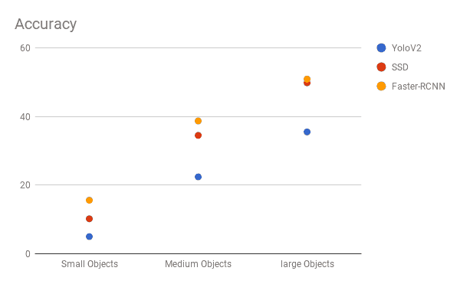
Literature review
Some pretrained models :
1) Faster- RCNN [5]
2)Single shot Multibox detector[6]
3) YOLO V2 [7]
[5] Ren, Shaoqing, et al. "Faster r-cnn: Towards real-time object detection with region proposal networks." Advances in neural information processing systems. 2015. [6] Zhang, Zhishuai, et al. “Single-Shot Object Detection with Enriched Semantics”. Center for Brains, Minds and Machines (CBMM), 2018. [7] Redmon, Joseph, and Ali Farhadi. "YOLO9000: better, faster, stronger." arXiv preprint (2017).
Notes:
SSD performs worst on small objects of all detections
Ssd - independent of choice of feature extractor while faster rcnn is impacted by choice of feature extractor
For large objects, SSD can outperform Faster R-CNN and R-FCN in accuracy with lighter and faster extractors.

Slide 7
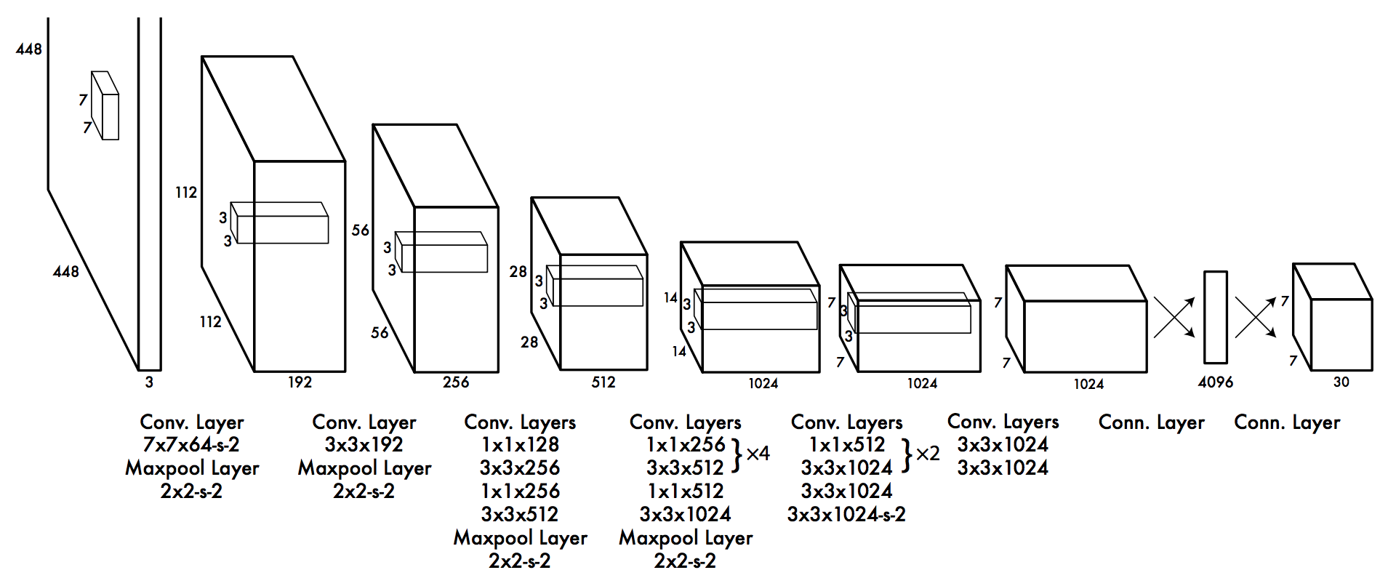
YOLO
Source: You Only Look Once:Unified, Real-Time Object Detection Joseph Redmon,Santosh Divvala,Ross Girshick, Ali Farhadi University of Washington Allen Institute for AI

Slide 8
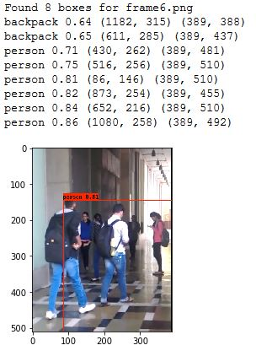
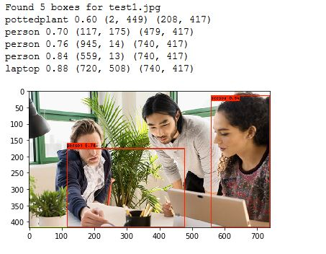
Results - YOLO

Slide 9
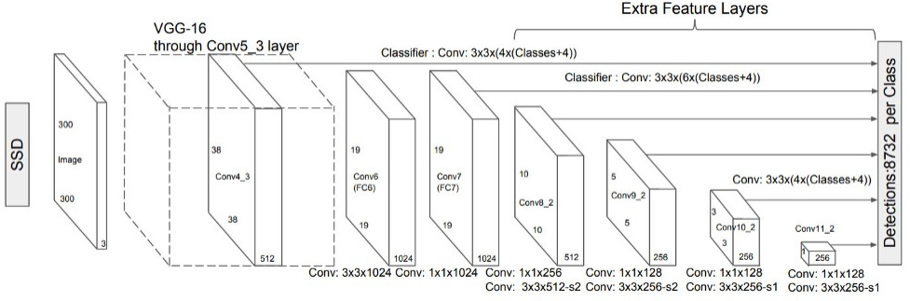
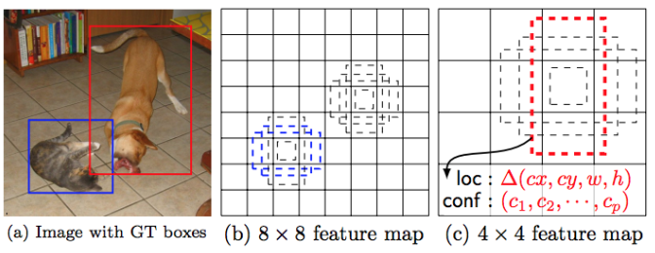
SSD detection
( a) SSD Architecture
( b) SSD feature map
Source : https://medium.com/@jonathan_hui/ssd-object-detection-single-shot-multibox-detector-for-real-time-processing

Slide 10
Faster RCNN (Region Based CNN)
RCNN Uses Selective Search which reduces number of bounding boxes. Faster and computationally less expensive than CNN. 1. Run selective Search 2. CNN + SVM 3.Optimize by training bounding box regression | Fast RCNN made it possible to train end-to-end. they added the bounding box regression to the neural network training itself. This in turn reduces overall training and increases accuracy. | Faster RCNN Fastest among all discussed so far. Region Proposal Network

Slide 11
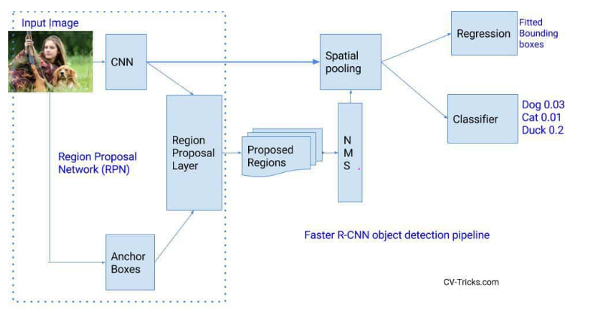
Faster RCNN
Fig. 2. Faster RCNN architecture
Source : https://cv-tricks.com/object-detection/faster-r-cnn-yolo-ssd/

Slide 12
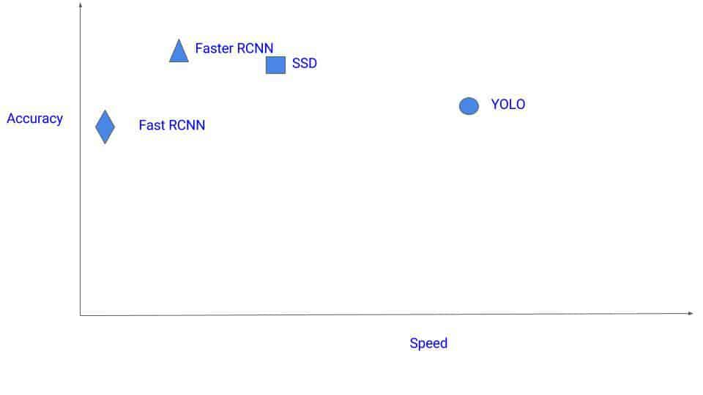
Results and Discussions
We implemented Faster- RCNN, SSD and YOLOv2 using tensorflow as a part of comparative study.
Results:
Faster R-CNN is more accurate than SSD and YOLOv2.
Faster R-CNN can able to classify more smaller objects compare to SSD.
YOLO and SSD are more faster then faster-RCNN.
SSD is fast but performs worse for small objects comparing with others.

Slide 13
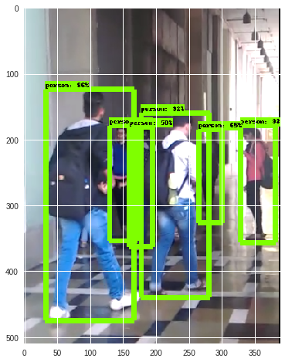
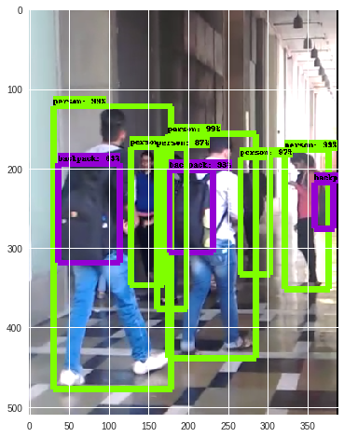
( a ) SSD
( b ) Faster RCNN

Slide 14
References
[1] Lin, Tsung-Yi, et al. "Microsoft coco: Common objects in context." European conference on computer vision. Springer, Cham, 2014.
[2] Everingham, M. , Van Gool, L. , Williams, C. K. I. , Winn, J. and Zisserman, A. International Journal of Computer Vision (2010)
[3] S. Ren, K. He, R. Girshick and J. Sun, "Faster R-CNN: Towards Real-Time Object Detection with Region Proposal Networks," in IEEE Transactions on Pattern Analysis & Machine Intelligence, vol. 39, no. 6, pp. 1137-1149, 2017.
[4] : Liu W. et al. (2016) SSD: Single Shot MultiBox Detector. In: Leibe B., Matas J., Sebe N., Welling M. (eds) Computer Vision – ECCV 2016. ECCV 2016. Computer Science, vol 9905. Springer, Cham
[5] Ren, Shaoqing, et al. "Faster r-cnn: Towards real-time object detection with region proposal networks." Advances in neural information processing systems. 2015.
[6] Zhang, Zhishuai, et al. Single-Shot Object Detection with Enriched Semantics. Center for Brains, Minds and Machines (CBMM), 2018.

